Slide 1
Angouleme dated 25th June 2012.
M.Gouges, Y.Somalwar

Slide 2
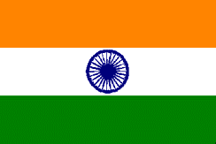
India – Facts
Official Name | Bharat (Hindi), Republic of India (English)
Federal Republic | Formed of 29 States & 6 Union Territories
Independence | 15th August 1947
Capital | New Delhi
Population | 1,2 Bn as per census year 2011
Area | 3.3 million square kilometers
Time zone | GMT +05:30
Coastline Length | 7600 km
Languages | National languages : Hindi and English; recognizes 22 regional languages.
Major Religions | Hinduism, Islam, Christianity, Buddhism, Sikhism, Jainism
Currency | Rupee (Rs.) → Exchange Rate: 1USD = Rs.54 (June 2012)
Headed by | President elected for five-year term by National & State Legislatures Pratibha Patil – President Today. New President in July’12.
National Executive | Prime Minister chosen from elected members of parliament Dr. Manmohan Singh ( of Congress Party) – Prime Minister today.
National Flag
35 states, 1618 languages, 6400 castes, 6 religions, 6 ethnic groups, 29 major festivals & 1 country

Slide 3
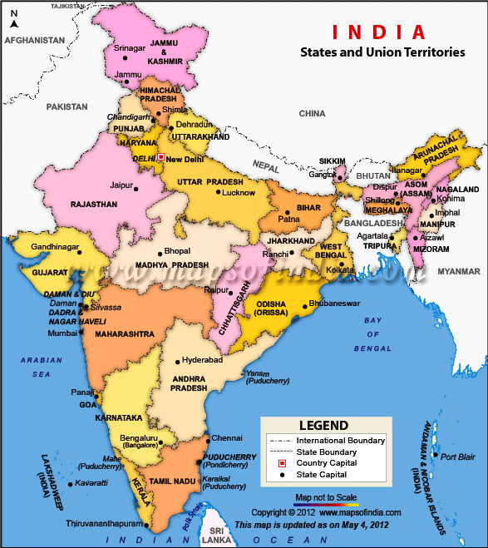
India- State & Region wise facts
INDIA Political Map
Normally the country is divided in 5 zones.
North India.
West India
South India
East India
Central India.
In all the above regions, the Religion, the
thinking, the business ideas differs.
Industrialization & business is spread in
North, West & South India with little
concentration on East & Central part.
Gujarat is the most industrialized state followed by
Maharashtra, Tamilnadu. Karnataka.
MNC’s such as Samsung, LG, Honda have a plant in
Noida (North India), Volkawagon in Maharashtra,
Hyundai, Nissan, Ford in Tamilnadu.
Bangalore & Hyderbad are main centres for IT
industry with DELL, HP, Infosys, TCS having their
software centres.

Slide 4
India on education Map
Kerala is the state with 100% literacy (education)
There are 15 Indian Institutes of India (IIT’s), 11 Indian Institute of Management (IIM’s) along with hundreds of State/Pvt. Owned engineering colleges. Most of MNC’s hires candidates directly from the institute.
Most middle class working families prefers their sons/daughters to be Engineers/Doctors.
No of Engineering passout’s per year - 750,000.
IPS - III # 033

Slide 5
Economic Growth Data Countrywise
Indian Economy is hit in spite of Global meltdown which is clear from the following indicators.

Slide 6
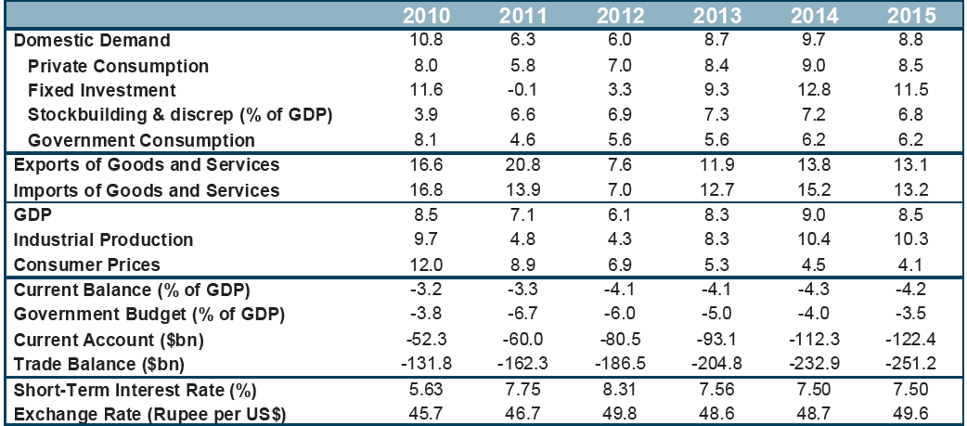
India Macroeconomic Summary & Forecast : 2012 - 2015
Shown in Calendar year Source: Oxford Economics

Slide 7
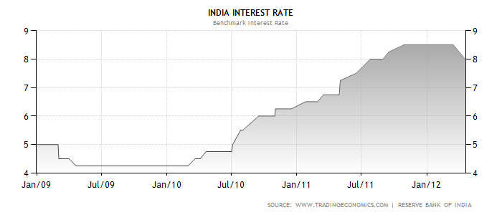
India Today – Key Macroeconomic Indicators
GDP Growth Slowing Down
Inflation 7.5 % (May 12)
Overall
Forecast
Manufactured Goods
Index of Industrial Production – Trending
Interest Rates – Still very High
Source: Government of India, Oxford Economics, Edelweiss, Dun & Bradstreet, Trading Economics

Slide 8
India Today- Macroeconomic indicators
Rupee Weakening
Exports shrinking
Exports in 2012 was 300Bn $.
Target for exports set up is 360 Bn $ for FY’13.
First 2 months of FY’13 (Apr-May) shows a
drop of 0.7% compared to two months of FY’12.
Exports
April-May’12
April-May’11
50.1Bn$
50.5Bn$
Engg exports down by 15.7% at 4.9BN$.
Petroleum Oil & lubricants down 26.1% to 4.1Bn$.
Gems & Jewellery exports down at 9% at 3.6Bn$.
Medicine up by 10.6% at 1.1Bn$.
Readymade garments declined 15.8% at 1Bn$.
GOVERNMENT stand: Explore Asian, African & Latin American markets.
3
Source: Government of India, Dun & Bradstreet, JPMorgan, Trading Economics

Slide 9
Long term forecast for India
 | 2013 | 2014 | 2015 | 2016
GDP | 7.5 | 8.7 | 8.5 | 7.9
Consumption | 8.3 | 8.8 | 8.5 | 7.8
Investment | 8.6 | 12.8 | 11.5 | 9.4
Govt.Consumption | 5.3 | 6.2 | 6.2 | 6.2
Exports | 7.8 | 11.5 | 13.6 | 12.9
Imports | 12.2 | 13 | 12.7 | 12.2
Unemployment (%) | 8 | 8 | 8 | 8
Consumer Prices | 5.4 | 4.5 | 4.1 | 3.9
Current Balance (% of GDP) | -3.7 | -4.2 | -4.2 | -4.2
Exchange Rate (Per $) | 51.9 | 51.7 | 52 | 52.3
IPS - III # 033

Slide 10
Is it a downturn or opportunity?
It is always easy to over react negatively & conclude that once economy is down, it’s going to keep down.
If we be India specific here, the economic downturn is a temporary phenomenon for the three reasons:
India continues to be a high growth country with 35% of national income being invested today. FDI in 2011-12 was 46.85 Bn $.
Government relaxing outflow of FDI & India today ranks 5th in the world after USA, Canada, Japan, & China.
Exports: Exports reported 300 Bn$ in 2012 thus forming a export to GDP ratio of 22% from a paltry 4.4% in 1961.
This current slow down must be taken as an opportunity to push major reforms such as retail which will benefit farmers.
What is RBI (Reserve Bank of India) & Government doing??
As May inflation touches 7.5%, Reserve Bank of India (RBI), may cut interest rates to boost growth in economy.
A good monsoon with strong agricultural growth may help growth & reduce inflationary pressures.
Government considering building warehouses & cold chain to address the current supply side constraints.
IPS - III # 033

Slide 11
EMERSON in INDIA
Specific Markets data

Slide 12













Emerson’s Presence in India
MOHALI
PWS IEC
NEW DELHI
APSCO Engaged Sites
Emerson Network Power , Thane
Emerson Process Management, Pawane
Emerson Climate Technology, Atit
Leroy Somer, Noida
ASCO India, Chennai
Trident Powercraft Pvt Ltd, Bangalore
Fisher Regulators
Fisher Valves
EDEC, EEEC
BARODA
MUMBAI
PAWANE
PUNE
HYDERABAD
KARAD/
ATIT
HUBLI
ECP
BANGALORE
CHENNAI
TRIDENT
FISHER

Slide 13
Motor Market Update (Production Statistics)
2008-09 | 2009-10 | 2010-11
Qty change | 28% | 17.5%
KW change | 12% | 14%
Ratings | % of total | Remarks
< 7.5KW | 28% | Dealer dominated. Strong competition
>7.5KW-45KW | 28% | OEM market.
>45KW-315KW | 39% | Mostly OEM/ Project requirements
>315KW | 5% | Project requirement.

Slide 14
Investments:
Some positive signals..
Foreign Investments
Domestic Players
$80B FDI Expected in Next 2 years; Up from ~$25B in 2011
BP-Reliance Mega Deal ($7.2B)
Automotive Majors To Invest $3B+
- Mercedes, BMW, VW, Bosch, etc
Japan looking at Major Investments
- Delhi Mumbai Industrial Corridor
($4.5B over next 5 years)
Government may push FDI in Retail in Second Half
Germany and Qatar considering investments in India
Reliance J3 & Other Project Investments $9B (expected)
A.V. Birla investing $10B by 2014
O & G majors – ONGC, GAIL, IOCL, HPCL planning investments
- GAIL $ 8bn by 2015; ONGC $ 5bn by 2014
Asian Paints setting up Asia’s largest Paint facility
NTPC Targeting Additional 40GW by 2017; 7GW Tenders under Award
20GW Solar Power Vision by 2020
0.3M New Jobs in IT/ITES Sectors
Jindal, Essar Group, Tata’s eye investments in Africa
Rate Cut By Central Bank (RBI) & FDI Will Help Start Building Momentum on New Investments
14
Notes:
Tata Chemicals – soda ash plant – 300M in Kenya
– 400K TPA/KLPA Paint & 160K TPA/KLPA Resins & Polymers
Coca-Cola and its partners will invest $2 billion (around Rs 10,000 crore) over the next five years to enhance its operations in India and set up a new plant
Toshiba JSW to double capacity to 6,000 MW
BS 14 Feb 2012 Toshiba JSW Turbine and Generator Pvt. Ltd., a joint venture between Japan-based Toshiba Corporation and India’s JSW Group, is planning to double capacity of its super critical steam turbine and generator manufacturing facility here to 6,000 MW by the financial year 2015.
JSW Energy to set up power plant in South Africa
ET 14 Feb 2012 Integrated power generator JSW Energy, looking for suitable acquisitions inside India, is planning to set up a 450-600-MW coal-fired plant in South Africa where the power sector is opening up for investment.
Qatar to invest $2 billion in India
Stating that New Delhi is a “key partner” of the Gulf Cooperation Council and that ‘cash-rich’ countries were now “increasingly looking towards India”, Qatar has said it will invest a whopping $ 2 billion in the country.
REpower wins 52 MW order for France projects
REpower Systems AG, in which Suzlon Energy Ltd. is a majority shareholder with 90.71 per cent holding and EOLE-RES S.A, one of the leading French wind and solar power developers, based in Avignon, have signed an agreement of the supply of 26 wind turbines.
Russia to build up to 16 nuclear reactors in India
Russia will build up to 16 nuclear reactors for power stations in India, Russia’s deputy premier said during a visit to India with Prime Minister Vladimir Putin to reaffirm decades-old ties.
India Inc invests $797 mn overseas in Jan
02 Feb 2012
Overseas investments by Indian companies stood at $797 million in January, with Tata Group, infrastructure major IL&FS and pharma major Lupin emerging as major investors.As many as 418 overseas investment transactions were carried out by various companies last month.
Essar plans to set up 6-mt refinery in Uganda
BL 14 Dec 2011
Ruias-owned Essar Oil Ltd has proposed to set up a 6-million-tonne refinery in Uganda even as it plans to invest $1 billion in more than doubling the capacity of its Kenya refinery. “There has been a big oil find in Uganda. To process it, they will need a refinery. We have suggested to the Ugandan Government that we can set up that refinery,” said Mr L.K. Gupta, the new CEO and Managing Director of Essar Oil.
Indian industry plans $ 10 bn investment in Afghan: Krishna
ET 6 Dec 2011
Unveiling India’s plans for Afghanistan, External Affairs Minister S M Krishna said Indian industry plans to spend over $ 10 billion developing mines and building a steel plant in the war-torn nation.
France to invest in Kerala
news.indiamart.com 23 Nov 2011
France has decided to invest in four sectors — energy, transportation, water treatment and waste management – in the state, said Mr Pierre Fournier, Consul-General of France. He has been speaking at an interactive meeting, which has been organised by the Kerala Chamber of Commerce and Industry. He has emphasised on the fact that infrastructure projects are considered as the basis for Kerala’s development.
ADB fires Rs. 30,000cr booster into Indian economy
nbmcw.com 25 Oct 2011
Ensuring India to smoothly handle the major financial hiccups and allied challenges coming in the way of its developmental activities, the Asian Development Bank (ADB) in a recent decision has cleared a three year India operations business plan providing financial assistance to the tune of Rs. 30,000cr ($6.25 billion). The financial booster will go a long way ensuring smooth, inclusive and sustainable growth across the country.
KEC International Ltd has won major order in Algeria worth Rs. 474 crore
CEEG Spa, has awarded five turnkey projects of 400 KV, 200 KV and 60 KV covering both single and double circuit transmission lines worth Rs. 474 crore to KEC. The total length of these five projects is 858 km and the completion period ranges from 12 to 18 months.
KEC International Ltd has bagged order worth Rs. 76 crore in Abu Dhabi for ERS
KEC will execute a project of modification and reallocation on existing lines with design and supply of Emergency Line Restoration System for Abu Dhabi Transport Authority / Ghantoot Transport & Gen. Cont. in Ruwais & Shuweihat . The project is to be completed within 12 months. The order is worth Rs. 76 crore.
Lupin investing $20M in new factory in Pune.
State-owned Oil and Natural Gas Corporation (ONGC) is investing nearly Rs 25,000 crore in bringing to production nearly a dozen marginal oil and gas fields by 2014. The 14 projects entailed an investment of Rs 27,305.05 crore. Of these three, Rs 506.22 crore development of D-1 field, Rs 219.77 crore SB-11 development and Rs 1,688.38 crore investment in development of Vasai East in western offshore, have been completed.Another 11 projects entailing an investment of Rs 24,890.38 crore are under various stages of investment.

Slide 15
India Sectoral Updates ~ till 2016
Longer Term Outlook Remains Strong
Process Management
Power | Expected to grow at >10%; Despite current issues, long term pipeline intact
Oil & Gas
Metals | Robust Growth : 12-15%
Chemicals | Steady Growth: ~9%
Industrial Automation
Renewable Energy (wind, solar etc) | 10-15% y-o-y growth in Infrastructure related project spend. Current Industrial growth sluggish; albeit medium to long term outlook strong.
Industry (Diverse) – Automobiles, ancillary etc.
Infrastructure , Construction , Material Handling
Climate Technologies
Residential & Commercial AC | Strong y-o-y demand; 10-15%
Industrial Refrigeration | Growing ~5-7% (Retail FDI key driver)
Network Power;
Embedded Computing& Power
Information Technology | Growing 10-12%
Telecom | 3G/4G &BWA Rollout ; License Cancellation a Deterrent
7

Slide 16
Major Private Business Houses in India
TATA GROUP: Revenues 83.8 Bn$.
Main Businesses: Steel, Automobile, Software, Hotels, DTH etc.
ADITYA BIRLA GROUP: Revenues 35 Bn$.
Main Business: Aluminum, Copper, Insurance, Retail etc.
RELIANCE GROUP: Revenues 66 Bn $.
Main Businesses: Crude Oil, Natural gas, Petrochemical, Petroleum, Polyster, Textile, Retail.
ADAG GROUP: Revenues 16 Bn$.
Main Businesses: Power, Telecom, Infrastructure, Health, Media etc.
IS IT ONLY INVESTMENT IN INDIA??
The Aditya Birla Group gets half of thier revenues from overseas operations.
Indian companies have invested 8Bn$ in last 4 months. Hotspots being Indonesia & Australia for coal & mining.
IPS - III # 033

Slide 17
How to start business in India
Korean & Japanese Companies are the most aggressive in India.
Start up business contacts can be developed by partcipating in major trade fairs such as Elecrama (once in 2 years), IMTEX (Indian machine tool exhibitions), Power Gen (once in 2 years), Textile fares or Hannover fair (G) where most of the Indian businessman travel..
Different business modes can be as under:
Appointing Distributors/Dealers. (margin expectation of min 15%).
JV with the Indian Co. (Majority/Minority stake). Perhaps this could help in getting good Sales revenues..
Green field which many MNC’s like Hyundai, Ford, Samsung, LG’s have done.
Approach for appointing Distributors/Dealers (Mumbay, Delhi)
Payment terms: Do not like LC, advance payment, but prefers open Credit of 60-90 days. One needs to have a relaxing Terms of payment.
IPS - III # 033

Slide 18
Business in India
Approach for JV/Green Field.
Need to approach Ministry of Trade & Commerce & Ministry of Finance.
Challenges ahead for Business in case of imports into India.
Bureaucratic approach.
Complicated taxes & duties structure.
Different rules from State to State.
Corruption levels some times. EMR/LS does not entertain the same.
IPS - III # 033

Slide 19
LEROY SOMER MOTOR in INDIA

Slide 20
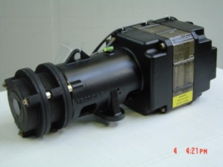
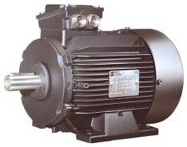
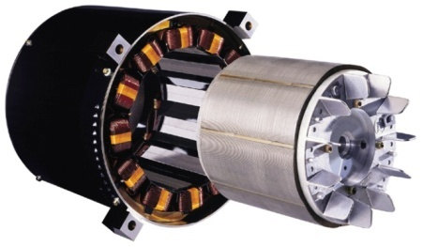

Leroy Somer Motors India-Introduction
Moteurs Leroy Somer started office in India in 1996 as a part of Emerson liaison office.
Being a part of liaison office, Direct Sales was done from France to Indian customers for both Alternators & Motors.
In 2001-2002, LS entered into a JV for Alternators to strengthen their presence in Alternator market.
LS Motors was established in 2007 as a Division of EECIPL for manufacturing Elevator Motors for Schindler. This was a part of Global agreement between Schindler & LS & today it contributes app 65% of the total LS Motors India Sales.
LS Motors also caters to various OEM’s for the balance 35% of our total business for different variety of Motors & Gears.

Slide 21
SELF experience
DIRECT SALES
Joined LS in 1996 & was first entrant in the company.
Our focus was on developing OEM’s for different applications like Extrusion machines, Packaging machines, compressors, pumps using our technoligical edge & global contract. Today this forms 30-35% app part of our business.
Our business for the above is direct between customers & DI & we act as a liason personnel.
We have no distributors/dealers due to the following:
High cost of import due to freight from France to Mumbai, road transportation to Noida, devaluating Rupee, & high taxes & duties.
Strong local competition.
IPS - III # 033

Slide 22
SELF experience
LOCAL MANUFACTURING
To serve Schindler locally, a new Company Leroy Somer Motor Division, a subsidiary of Emerson Electric Co.I ndia Pvt. Ltd was created.
Leased a Area of 465 Sqm as per our requirement.
Hired Emerson approved lawyer for due diligence & registered our production unit with local government authorities.
Did local registrations like Excise, Sales Tax, Factory license.
Did the first costing of material after selecting vendors for supply of lamination, Copper, Housings etc with import of components like Brakes, bearings, encoders from Overseas suppliers including LS subsidiaries.
Hiring of Factory Manager, Workers etc.
RESULT: Today the company has manufactured 6600 no of motors with a expected sales of 2.3 M € in FY’12 & we plan to move to double the Area in FY’13 with a intention to meet our customers growing demand, keep stocks of motors for our other parners such as Michelin, Kabra, IR etc.
After successful project, LSMD will intends to multiply this experience to explore other manufacturing options:
Local manufacturing is the key to have stronger presence for developing continued presence.
IPS - III # 033

Slide 23

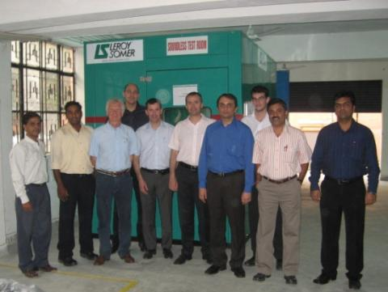
LSMD, sequence of Audits & Progress.
Pre-series (50 Motors)- Oct/Nov 2008.
SQA Audit:
18th March 2009 → Score 2.90/4 First Audit
  10th August 2009 → Official Approval for C8
Mass production- March 2009
29th October 2010 → Score 3.12/4 Second Audit
8th July 2011 → Score 93.18% Third Audit .
Till date supplied 6500 Motors.
2 years Start up period before mass production
Schindler Q Team

Slide 24
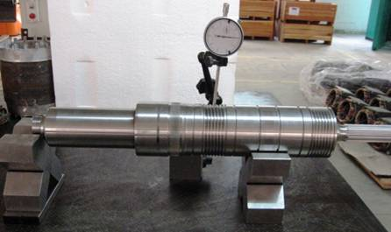
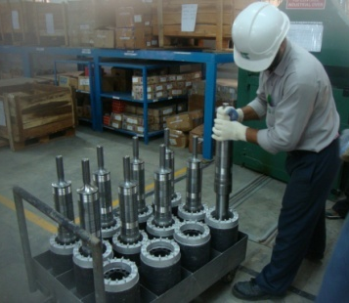
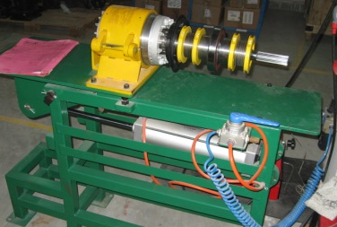
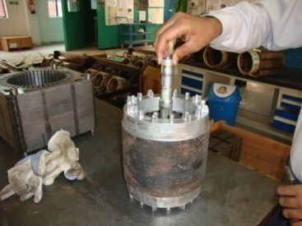
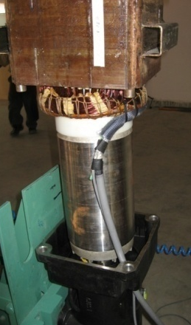
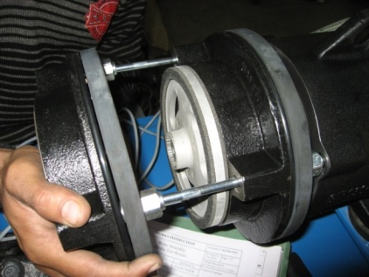
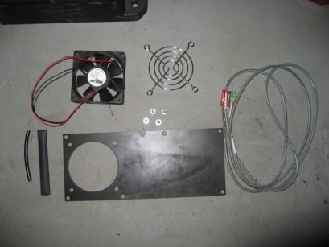
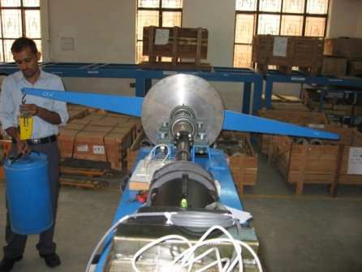
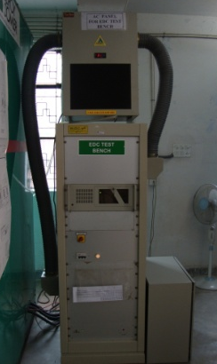
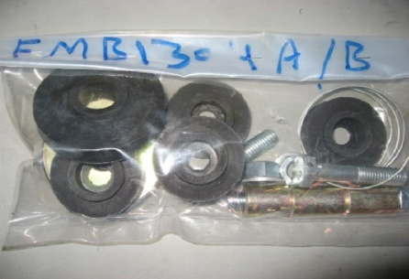
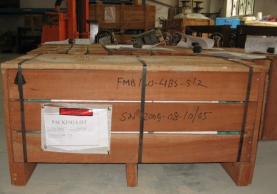
Processes at our premises in LSMD
Shaft IQC
Shaft insertion
Rotor assembly
Rotor mass IQC
Motor assembly
Brake assembly
Fan assembly
Brake test bench
EDC test bench
Damping pad preparation
Packaging

Slide 25
Why local manufacturing or a JV??
1. High taxes & duties.
FOB Price |  | 100 € | Net Impact after credit.
CIF | 10% | 10.0 €
Total |  | 110.0 €
Customs duty | 7.50% | 8.25 €
CVD | 12.5% | 14.78 € | Credit
Educational cess on CVD | 2% | 0.29 € | Credit
Sec & Higher edu. Cess on CVD | 1% | 0.14 € | Credit
Customs edu. Cess | 2% | 0.48 €
Customs Sec& higher edu cess | 1% | 0.24 €
Additional Duty | 4% | 5.36 € | Credit
Total after payment of duty |  | 139.54 € | 118.97 €
2. Devaluation of Rupee adding import cost.
3. Transportation time & cost.
4. Complications in clearing material at port with long waiting time.
5. Local presence making imports unviable solution.
IPS - III # 033

Slide 26
Indian Chamber of Commerce
D-118, 1st Floor,
Aashirwad Complex,
Green Park Main, New Delhi - 110016
Tel : 011 4610 1431 -38 , 4610 1439 (D)
Fax : 011 4610 1440 /1441
Email : energy@indianchamber.net
Website : www.indianchamber.net

Slide 27
Indo- French Chamber of Commerce & Industry
Address in Mumbai
Indo French Chamber of Commerce & Industry
French Bank Building, 4th Floor, 62 Homji Street, Fort - MUMBAI 400 001
Telephone: + 91 22 6747 9761
Fax: + 91 22 6747 9760
Email: contact (at) ifcci.org.in
Website: http://ifcci.org.in
Address in Delhi
Indo French Chamber of Commerce & Industry
A - 31, 3rd Floor
Firoz Gandhi Marg, Lajpat Nagar II
New Delhi 110 024, India
Telephone: + 91 11 4954 0093, Telefax: + 91 114954 0094
Email: contactdelhi@ifcci.org.in
Address in Chennai
Indo French Chamber of Commerce & Industry
Old 27, New 66, III Street, Abiramapuram - Chennai - 600 018
Telephone: + 91 44 4217 8710
Email: contactchennai@ifcci.org.in
Fondée en 1977 à Mumbai, l'Indo French Chamber of Commerce and Industry (IFCCI) est une organisation bilatérale qui compte plus de 500 membres actifs aujourd'hui.
Ces membres sont des entreprises françaises et indiennes dans tous les secteurs d'activité.

